Slide 1
ByteForce

Slide 2
Table of contents
01
02
Our Team
Our Idea
03
Used programs

Slide 3
01
Our Team

Slide 4
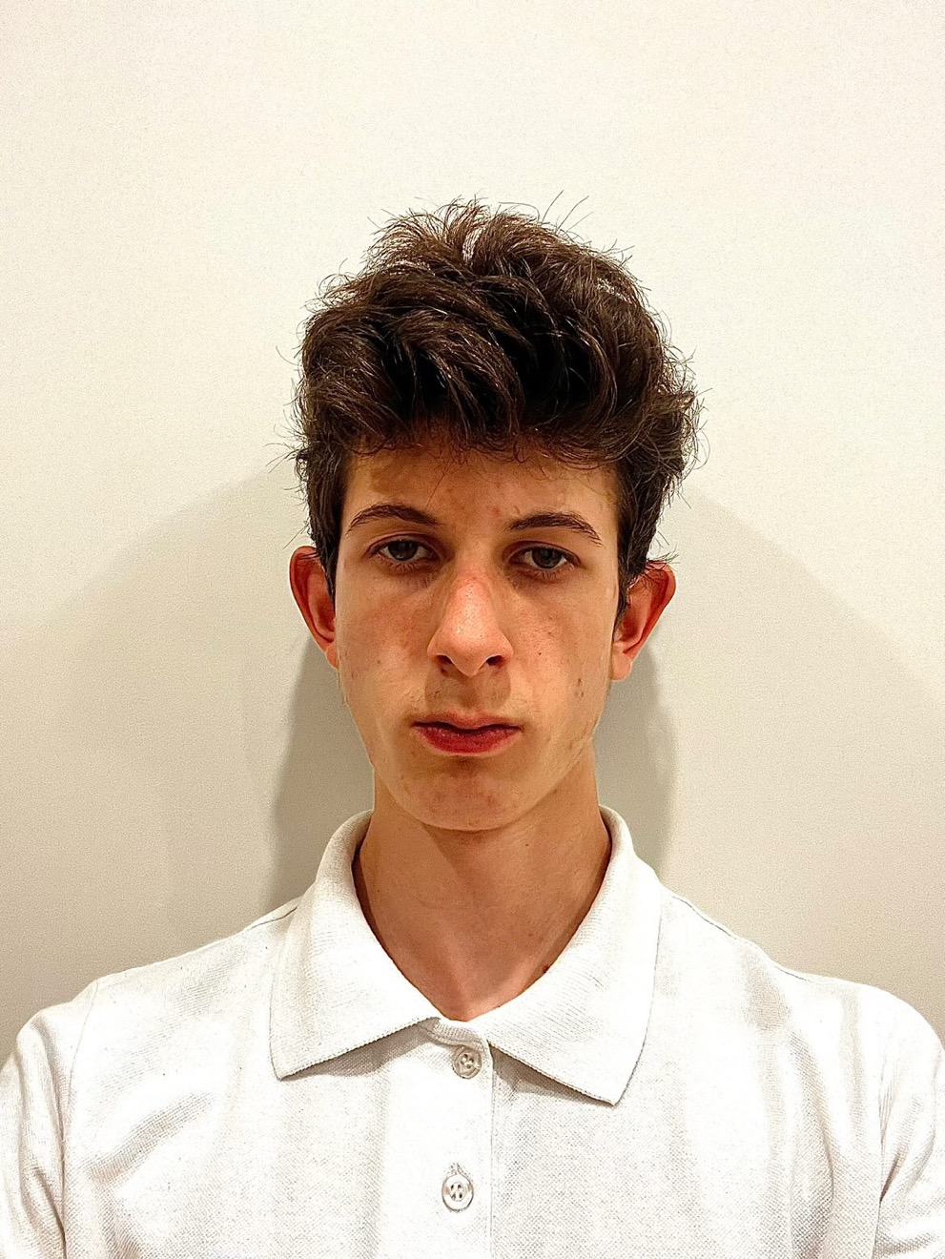
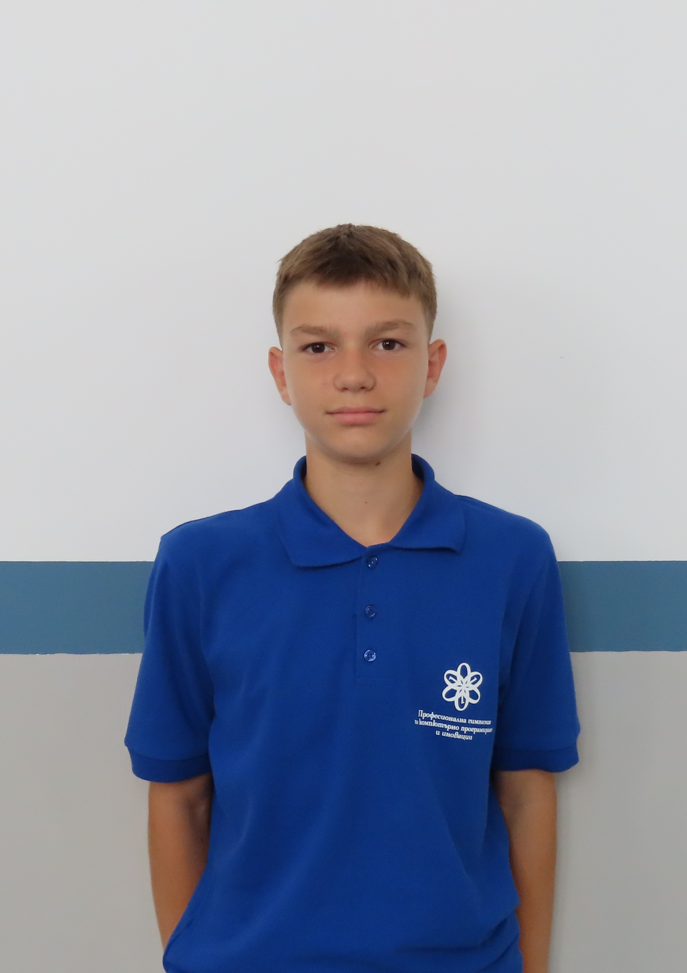
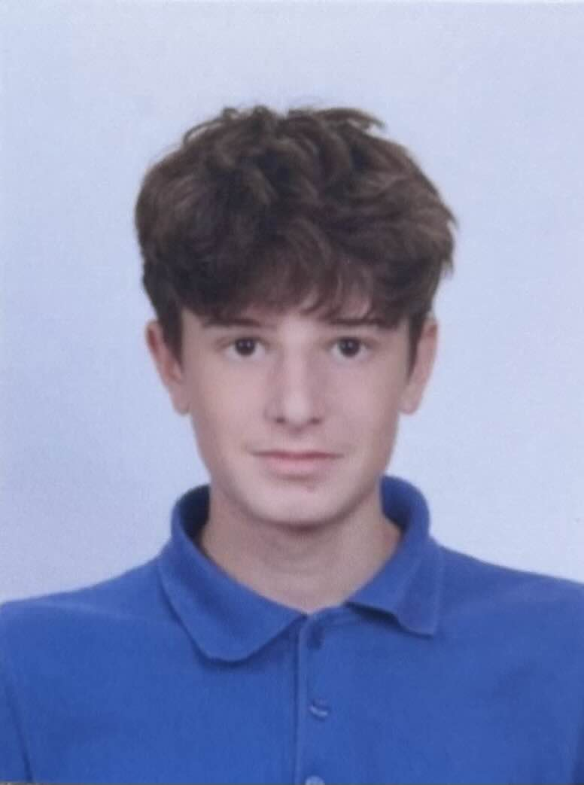
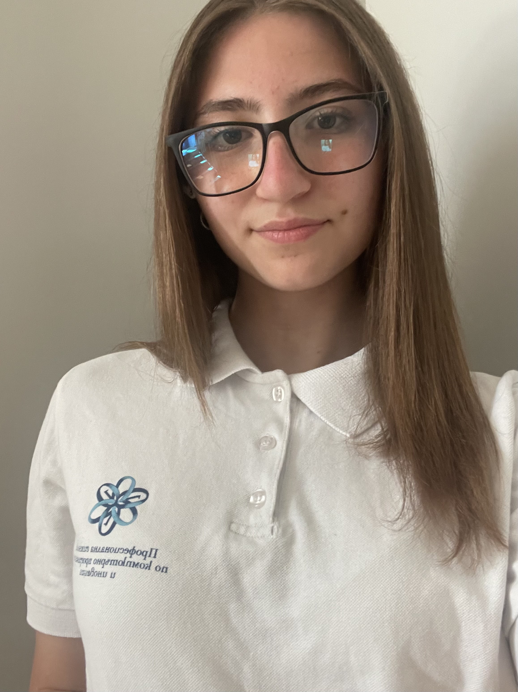
Aleksey Atanasov
Scrum trainer
Petar Stojkov
Back-end Developer
Danail Petrov
Front–end Developer
Valeriya Damyanova
Designer

Slide 5
02
Our Idea

Slide 6

About the game:
Our project is a crossword game for all ages. It is fun and interesting, because you can test and improve your vocabulary and also have fun.

Slide 7
03
Used programs

Slide 8









Slide 9
Let's jump into the game!

